Slide 1
SAFETY DURING THE HOLIDAYS
William
Paterson
University
Presented by Richard A. Baird
The Public Safety Department and University Police

Slide 2
Vision Statement
The holiday season is always a special time of year. It is also a time when busy people become careless and vulnerable to theft and other crimes. We can never be too careful, too prepared or too aware. On behalf of the WPU Police Department, I ask you to please share this information with family, friends and neighbors.

Slide 3

At Home

Slide 4
At Home
Lock your doors and windows, even if your only leaving for a few minutes.
When leaving for an extended period of time, have a neighbor or a family member pick up your mail and newspapers.
Indoor and outdoor lights should be on an automatic timer.
Leave a radio or television on so the house looks and sounds occupied.

Slide 5
At Home
Large displays of holiday gifts should not be visible through the windows and doors.
When setting up Christmas or other holiday displays, make sure doors and passageways are clear inside your home.
Be sure your Christmas tree is mounted on a sturdy base so children, elderly persons or pets cannot pull it over on themselves.

Slide 6
At Home
If you use display/tree lights ensure the wiring is not damaged or frayed.
  Frayed or damaged wiring can cause a fire.
Place your Christmas tree in water or wet sand to keep it green.
Never place wrapping paper in your fireplace.
Be diligent with lit candles.

Slide 7
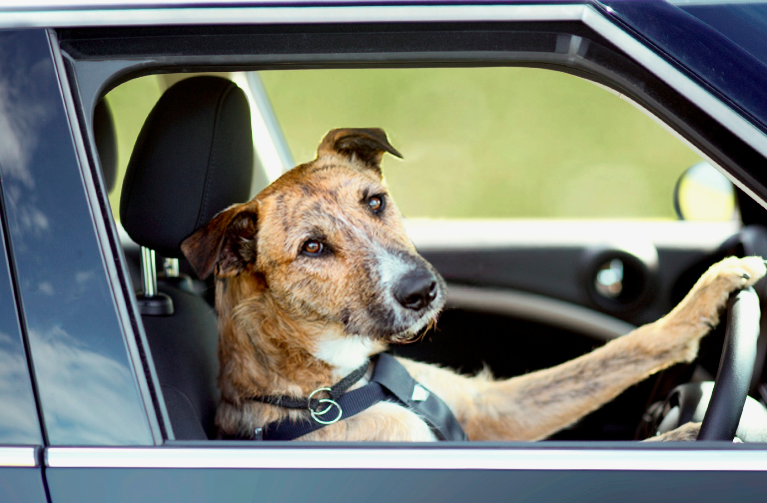
Driving

Slide 8
Driving
Keep all car doors locked and windows closed while in and out of car.
Remember to set your alarm.
If you must shop at night, park in a well lit area.
Avoid parking next to vans, trucks with camper shells or cars with tinted windows.
Park as close as you can to your destination and take notice of where you parked.

Slide 9
Driving
Never leave your car unoccupied with the motor running or with children inside. NOT EVEN FOR A SECOND!
Do not leave packages or valuables on the seat of your car.
  This creates a temptation for thieves.
  If you must leave something in the car, lock it in the trunk or put it out of sight.
Locate your keys prior to going to your car.

Slide 10
Driving
Keep a secure hold on your purse, handbag and parcels.
  Try not to put them down or on top of the car in order to open the door.
When approaching and leaving your vehicle be aware of your surroundings.
Do not approach your car alone if there are suspicious people in the area.
  Ask mall or store security for an escort before leaving your shopping location.

Slide 11
Driving
Check the interior of you car before “hopping in”.
Biggest threat of holiday season is motor vehicle crashes.
  Impairment, texting, speeding and being distracted in other ways greatly increase the likelihood of a motor vehicle crash.
Stay alert, be aware of other moving vehicles.

Slide 12
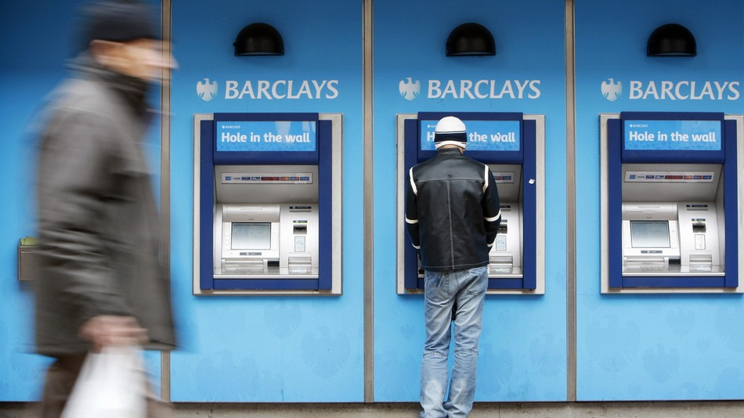
ATM

Slide 13
ATM
If you use an ATM, choose one that is located inside a mall or well lit location.
  Be aware of bushes and blind spots.
  Withdraw only the amount of cash you need.
Protect your pin number by shielding the ATM keypad from anyone who is standing near you.
Do not throw your ATM receipt away at the ATM location.

Slide 14

Shopping

Slide 15
Shopping
Shop during daylight hours whenever possible.
  If you must shop at night, go with a friend or family member.
Dress casually and comfortably.
Avoid wearing expensive jewelry.
Do not carry a purse or wallet, if possible.
Keep cash in your front pocket.

Slide 16
Shopping
Always carry your drivers license or ID card along with necessary cash, checks, and/or a credit card you expect to use.
Stay alert to your surroundings.
Avoid carrying large amounts of cash.
Pay for purchases with a check or credit card when possible.

Slide 17
Shopping
Notify the credit card issuer immediately if your credit card is lost, stolen or misused.
Keep a record of your credit card numbers in a safe place at home.
Be extra careful if you do carry a wallet or purse.
  They are prime targets of criminals in crowded shopping areas, transportation terminals, bus stops, on buses and other rapid transit.

Slide 18
Shopping
Avoid overloading yourself with packages.
  It is important to have clear visibility and freedom of motion to avoid mishaps.
Beware of strangers approaching you for any reason.
  At this time of year, con artists may try various methods of distracting you with the intention of taking your money or belongings.

Slide 19

Children

Slide 20
Children
If possible leave small children at home with a trusted person.
Teach your children to go to an identifiable store clerk, if possible, and ask for help if you become separated.
Teach your children to stay close to you at all times.
Teach your children to trust Police Officers.

Slide 21
Children
Never allow children to make unaccompanied trips to the restroom.
Children should not be allowed to go to the car alone and they should never be left alone in the car.
Teach children their full name, address and telephone number to give police officers or mall security.

Slide 22
Children
Teach children to immediately inform you if a stranger is bothering them!

Slide 23

Strangers At Your Door

Slide 24
Strangers at Your Door
Be aware that criminals sometimes pose as couriers delivering gifts.
It is not uncommon for criminals to take advantage of the generosity of people during the holiday season by soliciting donations door to door for charitable causes although no charity is involved.
Donate to a recognized charitable organization.

Slide 25

Online Shopping

Slide 26
Online Shopping
Online Shopping Dangers
  Identity Theft
  Credit Card Fraud
  Theft
  Counterfeit Goods
These crimes are still more prevalent in the “real” world, but trends are shifting.
Think before you click.

Slide 27
Online Shopping Tips
Choose Credit Over Debit
  Credit cards have much better fraud protection.
  Disposable credit cards are even better.
Verify Website Security
  Some online web sites don’t offer secure shopping.
  Limit yourself to secure sites.
    Look for Https:// instead of Http://
    Secure sites will also have a small lock in the lower right corner of the screen.

Slide 28
Online Shopping Tips
Don’t Shop Publically
  Don’t use a shared or public computer to shop online.
  Don’t use open or shared networks when shopping online.
Don’t Store Information Elsewhere
  One click shopping is faster, but the risk is greater.
  Data breaches are becoming more and more common.
Shop At Trusted Websites
  If it appears to be too good to be true, it usually is!

Slide 29
S.C.A.M.
(S)tingy: Be stingy about giving out your personal information to others unless you have a reason to trust them, regardless of where you are.
(C)heck: Check your financial information regularly, and look for what should be there and what shouldn’t.
(A)sk: Ask periodically for a copy of your credit report.
(M)aintain: Maintain careful records of your banking and financial accounts.

Slide 30
STAY ALERT!

